Slide 1
Agile Software Development (DIT191 / EDA397)
Eric Knauss
<eric.knauss@cse.gu.se>

Slide 2
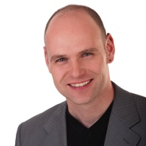


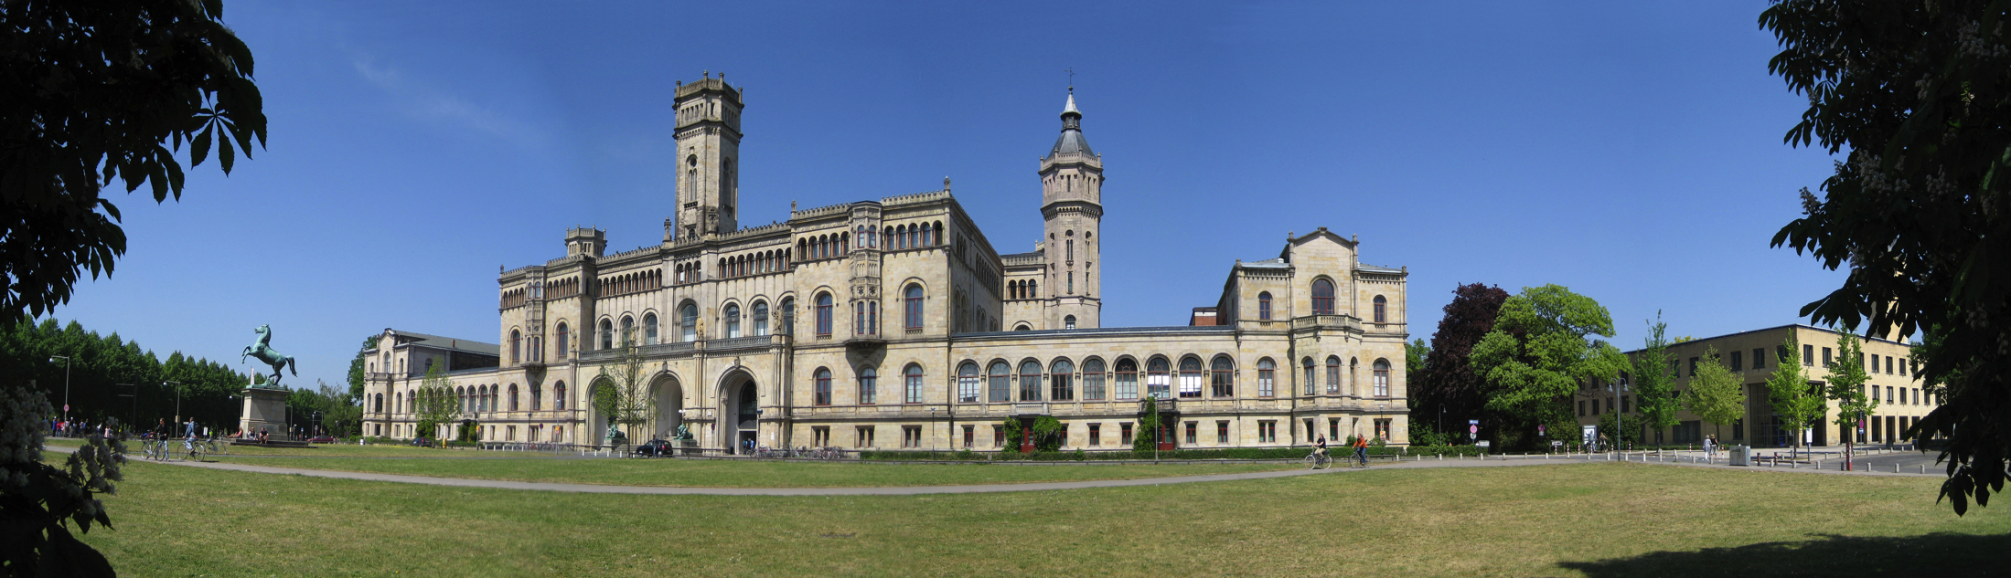







Hi, nice meeting you! (Short CV)
Born in Hattingen, Germany
University in Dortmund and Hanover
PhD in Hanover: Improving Requirements Documentation based on Heuristics and Experience
Postdoc in Hanover: Global Software Development
Postdoc in Victoria BC: RE in Distributed Large- Scale Software Projects
Topics
Requirements Engineering
Agile Methods
RE and Project Management
Experience and Knowledge Management

Slide 3
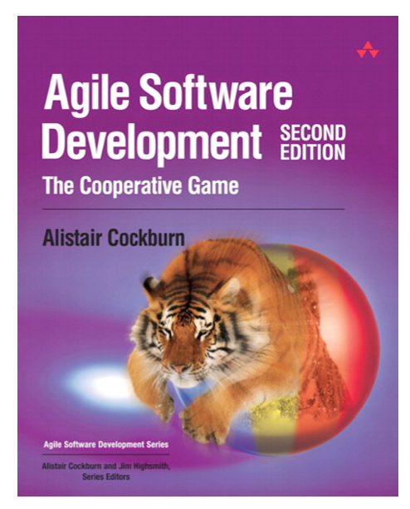
Course setup
Teaching Assistants
Terese Besker <besker@chalmers.se>
Magnus Ågren <magnus.agren@chalmers.se>
Course representants
In parallel:
PhD course
Course Material
http://oerich.github.io/EDA397/
Cockburn,A., (2009) Agile Software Development, 2ed
Papers

Slide 4
Course setup (Practical details)
Schedule
0-3 lectures per week
0-2 workshops per week
=3 scheduled activities per week
Even if there is no lecture, we will be available and you can (should!) use the rooms/time to work!
Examination
Project (teams)
Final product
Artifacts
Report (Individual)
Experience / Post-Mortem report
Written exam

Slide 5
Examination
Written exam, individual, 3.0 credits
60 points, 24 required to pass
Project, 4.5 credits
Grades: Fail/Pass based on project participation and group report
Grades
Chalmers:
X < 24 → Fail,
24 ≤ X < 36 → 3,
36 ≤ X < 48 → 4,
48 ≤ X → 5
GU
X < 24 → Fail,
24 ≤ X < 48 → G,
48 ≤ X → VG

Slide 6
Project
Develop an Android app for a customer
Work in predetermined teams
https://github.com/oerich/EDA397/wiki/Groupings-of-Teams
You will be assigned teams
Focus on agile practices and methodology
You meet with the customer this Thursday
and get all the details!
We strive to create a realistic scenario/ environment
We rely on a number of real-world services and tools, e.g.
Android (SDK), GitHub, Trello, (perhaps Jenkins, Gerrit, SonarCube…)

Slide 7
Course setup
Three sprints
Sprint 1: Getting started
Sprint 2: Getting work done
Sprint 3: Theory and advanced concepts

Slide 8
Course Objectives
Knowledge and understanding | Skills and ability | Judgement and approach
Compare agile and traditional softw. dev, | Forming a team organically | Explain: people/commun. centric dev.
Relate lean and agile development | Collaborate in small software dev. teams | Apply fact: people drive project success
Contrast different agile methodologies | Interact and show progress continuously | Describe: No single methodology fits all
Use the agile manifest and its accompanying principles | Develop SW using small and frequent iterations | Discuss: methodology needs to adopt to culture
Discuss what is different when leading an agile team | Use test-driven dev. and automated tests
 | Refactor a program/design
 | Be member of agile team
 | Incremental planning using user stories
Sprint 3
Sprint 1
Sprint 2

Slide 9
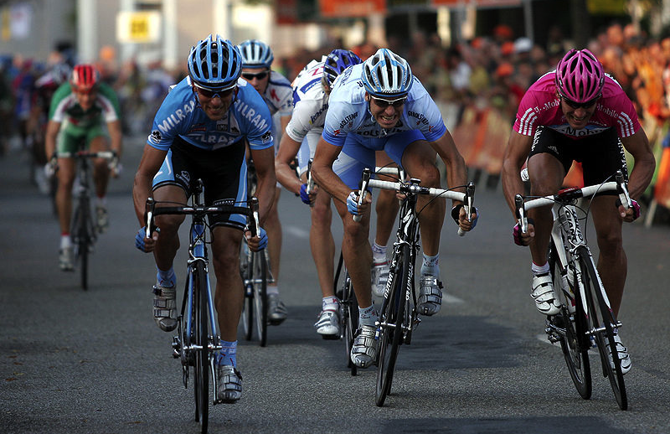
Sprint 1: Getting started
http://commons.wikimedia.org/wiki/File:Sprint_01.jpg

Slide 10

What is agility in Software Development?
Agile: An Overview
http://mediagallery.usatoday.com/New+Flame

Slide 11
Motivation
What is the “Software crisis”?
Software development inefficient
Software does not meet requirements
Projects over time/budget
Projects were unmanageable and software unmaintainable
What can be done about it?
Software Engineering
Application of engineering to Software
Systematic, disciplined, quantifiable approach to the development, operation, and maintenance of software
Assure quality of process and product

Slide 12
?
Do you know examples of
Systematic, disciplined, quantifiable approaches to the development, operation, and maintenance of software?
Applying engineering to software?

Slide 13

Where are we coming from?
Requirements
Design
Programming
Test
http://commons.wikimedia.org/wiki/File:Waterfall_katoomba.JPG

Slide 14
Systematic sequential development
Requirements
Design
Programming
Test
Advantages
Simple
Controllable
Cost efficient
Problems
Time-to-market
What about change?

Slide 15
Towards concurrent development
Requirements
Design
Programming
Test
What can we do if time to market and robustness against late changes are more important than cost-efficiency?
Requirements
Design
Programming
Test
Time-to-market
Time-to-market

Slide 16
?
What is the consequence of concurrent development?
(hint: why are concurrent tasks depicted longer than sequential tasks?)
What has this to do with agile?
What do you know about agile?

Slide 17
Iteration Models
System requirements always evolve during a project
Iterations are part of larger development projects
Iterations can be applied to any generic development process model

Slide 18
Incremental delivery
Define outline requirements
Assign requirements to increments
Design system architecture
Develop system increment
System incomplete
Validate increment
Validate system
Integrate increment
Final delivery

Slide 19
Incremental delivery
Customer value can be delivered with each increment so system functionality is early available for customer’s feedback
Early increments act as prototype to help elicit requirements for later increments
Reduced risk of project failure
The highest priority system services tend to receive the most testing

Slide 20
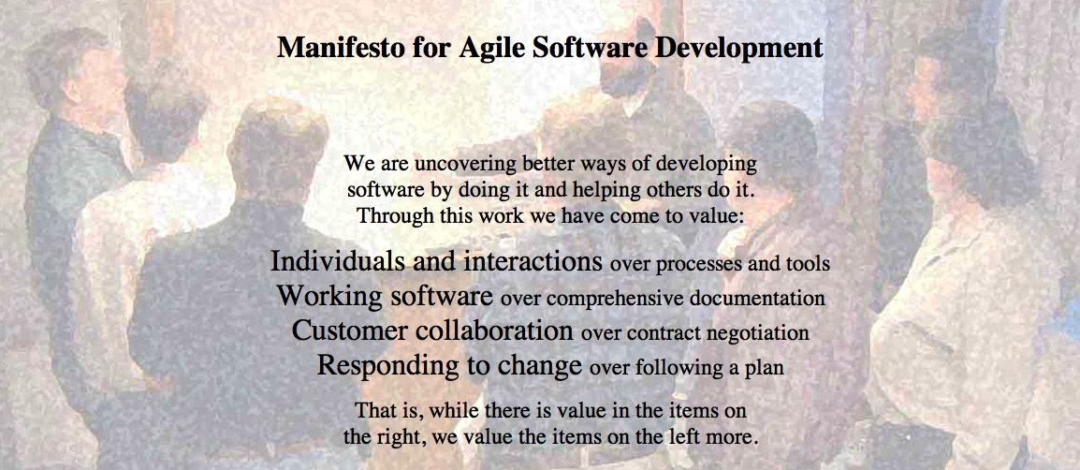
Agile Manifesto
http://agilemanifesto.org
Began as a provocation: Plan-driven development did not safe the Software world…
Now a very serious movement, well adapted in industry.
There are a couple of established agile methods: How to integrate these values in everyday software development

Slide 21
?
Can the following projects be agile?
App development
Online shop
Mission controller for Airplane
Controller for nuclear plant

Slide 22
XP Practices
Feedback
Pair Programming
Continuous process
Onsite-Customer
Small releases
Test-first
Continuous integration
Planning game
Refactoring
Shared understanding
Programmer welfare
Coding standards
Sustainable pace
Collective Code Ownership
System metaphor
Simple design

Slide 23
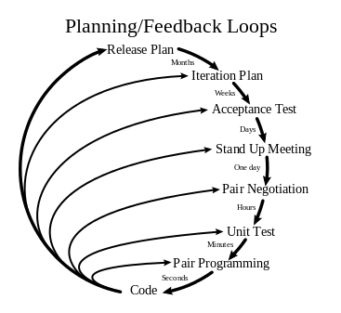
XP:
http://en.wikipedia.org/wiki/File:Extreme_Programming.svg

Slide 24
Agile Methods: eXtreme Programming (XP)
Extreme programming:
An approach based on the development and delivery of very small increments of functionality
No fine grained process description, but 12 practices arranged around short development circles (4-6 weeks)
“Turn-to-ten” metaphor (refers to volume setting of older amplifiers):
Reviewing is good? → Review continuously: Pair Programming
Early Tests are good? → Write tests before code: Test-First
Customer interaction is good? → Have Onsite-Customer
…

Slide 25

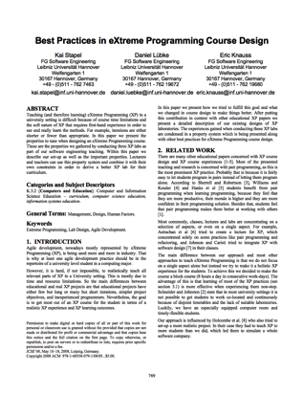
Planning Game
Business people need to decide
Scope, Priority, Composition of release, dates of release
Technical people need to decide
Estimates, Consequences, Process, Detailed scheduling
[Bec1999]
“Students learn how to divide requirements into User Stories and how to prioritize and estimate the costs of these stories. While such tasks seem to be easy in theory, dealing with dependencies in the planning game is normally a challenge for inexperienced developers like students.”
(+) More iterations, small teams, customer interested, technical support, progress feedback
(-) Longer iterations
[SLK2008]

Slide 26
Small releases
Every release
… should be as small as possible
… should contain the most valuable business requirements
… has to make sense as a whole
… should be delivered every 4-8 weeks (rather than 6-12 month)
“Students learn the benefits of small releases that already offer value to the customer and how to technically put a system into production including packaging.”
(+) More iterations, progress feedback

Slide 27
Metaphor
Examples
Naïve: “Contract management system deals with contracts, customers, and endorsements”
“Computer should appear as a desktop”
“Pension calculation is a spreadsheet”
Align team thinking
“Students learn how to develop a metaphor that helps every team member to better understand how the whole system works.”
(+) Technical support, technical feedback

Slide 28
Simple Design
The right design at any given time
Runs all the tests
Has no duplicated logic
States every intention important to the programmers
Has the fewest possible classes and methods
“Students learn the benefits of simple software design which improves their ability to change the system quickly and accommodate it to changing requirements.”
(+) More iterations, technical support

Slide 29
Testing
Any feature without automated test does not exist
Don’t write a test for every method
Write a test for every productive method that could possibly break
“Program becomes more and more confident over time”
“Students learn how to use unit test frameworks and the test-first approach to build high quality software and to recognize the advantages of well-tested code when making changes.”
(+) More iterations, technical support, technical feedback

Slide 30
Refactoring
Is there a way of changing the program to make it easier to add a new feature?
After adding the feature: Can we simplify the design?
Important investment!!!
“Students learn to refactor the software to remove duplication, improve communication and simplify the code base. Especially refactoring large systems can be troublesome and is a worthy experience that can only be made in long lasting projects.”
(+) More iterations, customer interest, technical support

Slide 31
Refactoring
Is there a way of changing the program to make it easier to add a new feature?
After adding the feature: Can we simplify the design?
Important investment!!!
“Students learn to refactor the software to remove duplication, improve communication and simplify the code base. Especially refactoring large systems can be troublesome and is a worthy experience that can only be made in long lasting projects.”
(+) More iterations, customer interest, technical support

Slide 32
Pair Programming
Driver: Has the keyboard, writes the code
Navigator: Thinking strategically
Will this work? Which test cases might not work? Can we simplify?
“Students learn and experience the principles of pair programming, the advantages of writing software with a partner and the social challenges that are associated.”
(+) Block course, small team size, technical support
(-) Long iterations

Slide 33
Collective Code Ownership
“Anybody who sees an opportunity to add value to any portion of the code is required to do so at any time.”
No code ownership → Chaos
Individual code ownership → Stable but slow
“Students get to know the advantages of collective code ownership and the challenges that arise with parallel updates and changes to their own code by other team members. ”
(+) Block course, small team size

Slide 34
Continuous Integration
Integrate and test code every few hours (1 day at the most)
Dedicated machine helps
If Machine is free: pair sits down, integrates their changes, tests, and does not leave before 100% of tests run
“To counter conflicting updates to the code base, students learn to integrate and build the software frequently. ”
(+) Block course, longer iterations, more iterations, small team size
(discovered later: technical feedback)

Slide 35
Sustainable pace (aka 40h week)
Be fresh every morning, tired every night
One week of overtime must not be followed by another one
“In contrast to normal life in university, students experience to work continuously for 40-hours per week in a designated team room.”
(+) Block course

Slide 36
On-Site Customer
Real customer in the room
Answers all questions now (…and can revise answer later)
Customer proxy
Answer now more important than answer correct
“Students have to interact with a designated On-Site Customer who is available full-time to answer questions.”
(+) Block course, customer interest

Slide 37
Coding Standards
Swapping partners, changing concurrently all parts of the code…
Your code should better look consistently!
Once and only once rule
Emphasize communication
Adopted by whole team
“Students experience the importance of uniform coding conventions throughout the team especially when combined with collective code ownership. ”

Slide 38
Agile Principles and Practices
Goal: Try them out in your project!
 | Mandatory | Optional | Comment
Planning Game | 1 | 0 | Make the most out of it. Get Emil's Priorities based on your effort estimation. Employ customer proxy
Small Releases | 1 | 0
Metaphor | 0 | 1 | Try it out! But we will not check whether it works.
Simple Design | 1 | 0
Test-First | 1 | 0 | But only where it makes sense. Have a good rationale!
Refactoring | 1 | 0
Pair Programming | 0,5 | 0,5 | Try it out. Don't necessarily do it all the time.
Collective Codeownership | 2 | 0 | Everybody should know about the code. Some parts more than others
Continuous Integration | 1 | 0
Sustainable Pace | 1 | 0 | But also not too slow!
Onsite Customer | 0,5 | 0,5 | Have a customer proxy
Coding standards | 1 | 0 | Decide on them and try to have tool support

Slide 39
References
[Bec1999]
Kent Beck, Extreme Programming Explained, Addison-Wesley, 2ed, 2000
[SLK2008]
Kai Stapel, Daniel Lübke, Eric Knauss: Best Practices in eXtreme Programming Course Design. In: Proceedings of the 30th International Conference on Software Engineering (ICSE '08), Leibzig, Germany, pg. 769-776, 2008

